Slide 1

What is the Women’s March? Inona ny diaben’ny vehivavy? The women’s march is an event that promotes equal rights for women, and celebrates the importance of women in society. Ny diaben'ny vehivavy dia hetsika fa manome lanja ny zon’ny vehivavy, ary mankalaza lanjan' ny vehivavy eo amin'ny fiarahamonina.

Slide 2
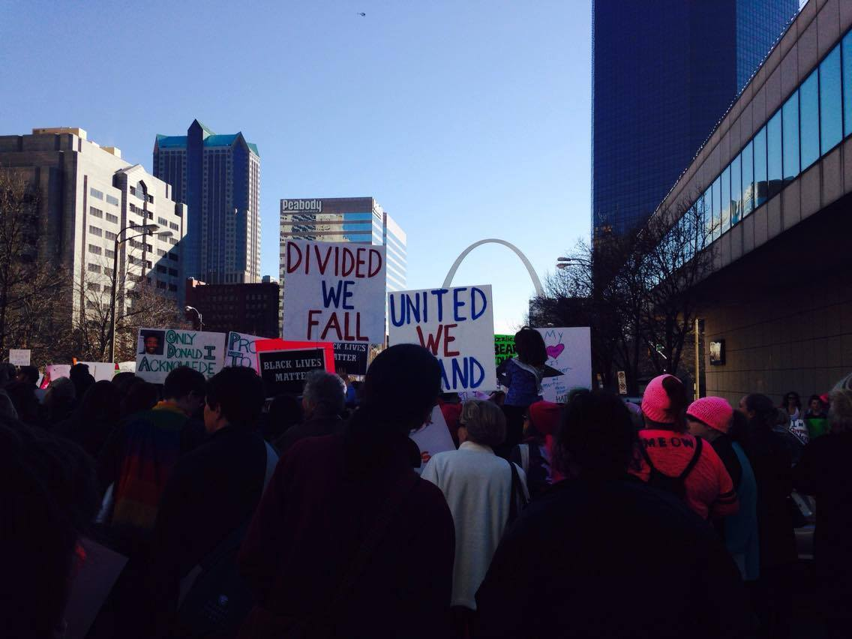
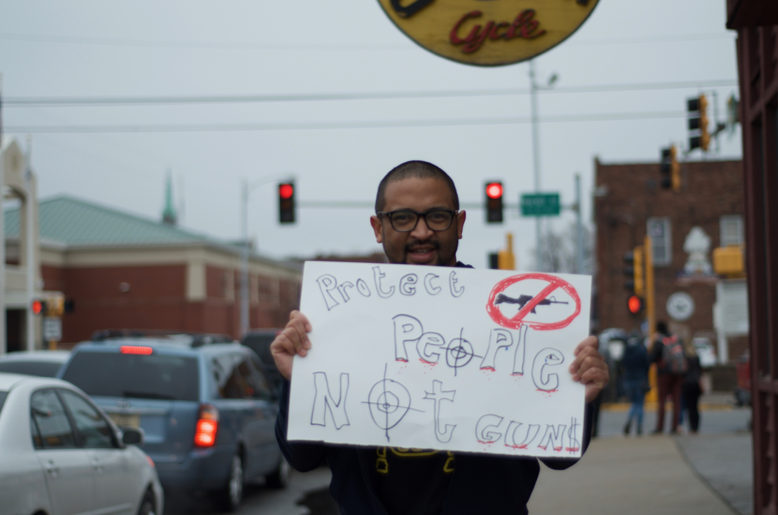
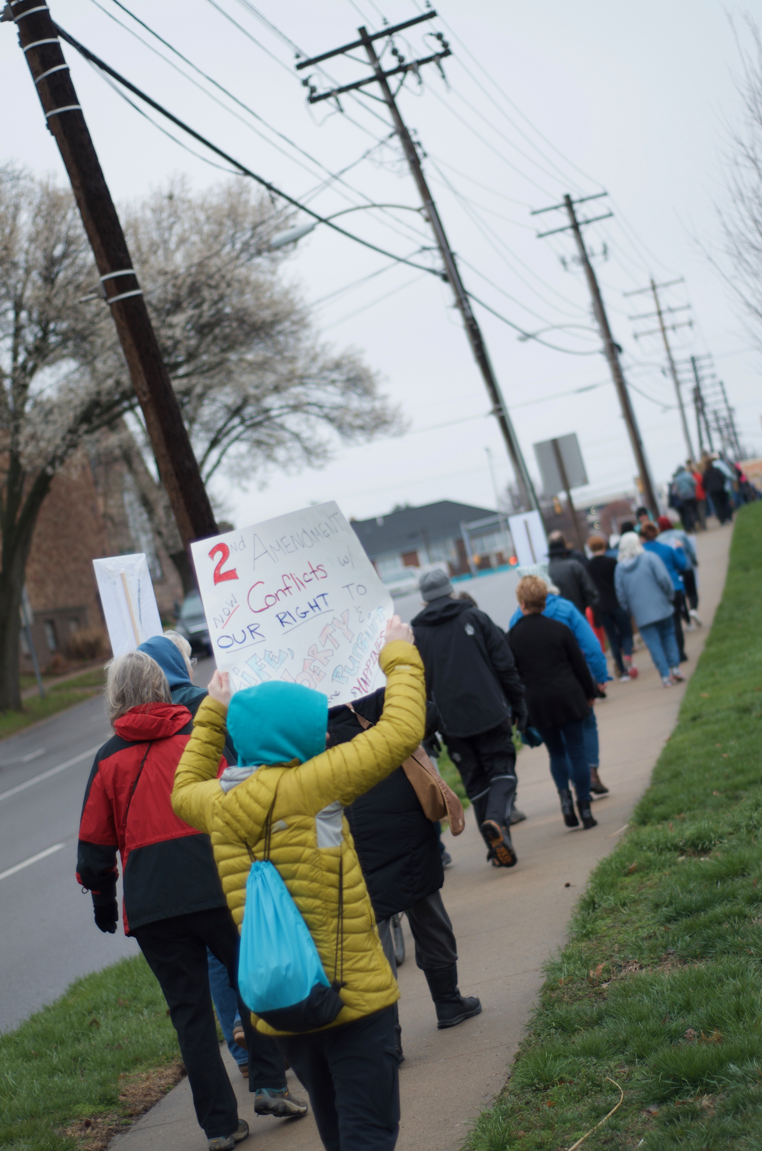
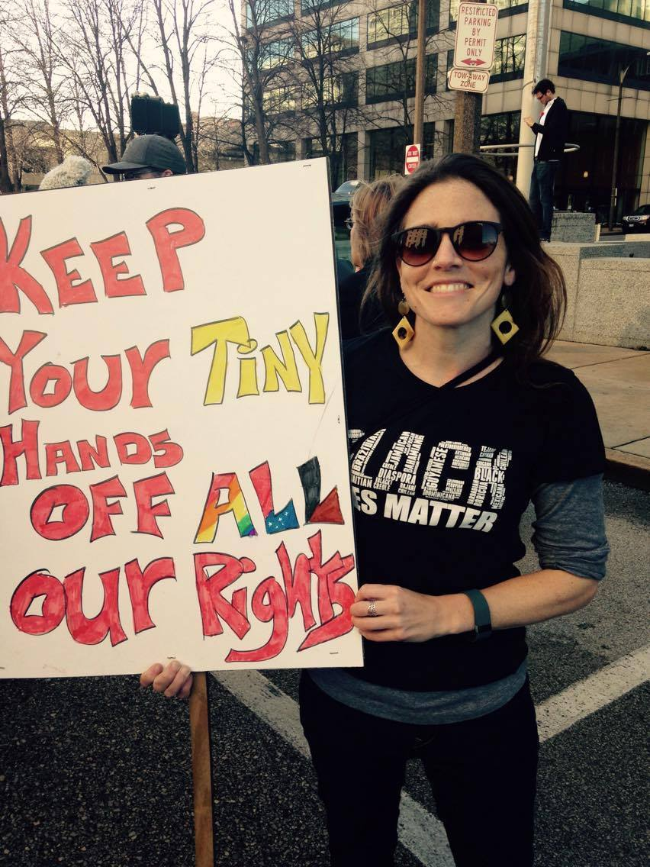
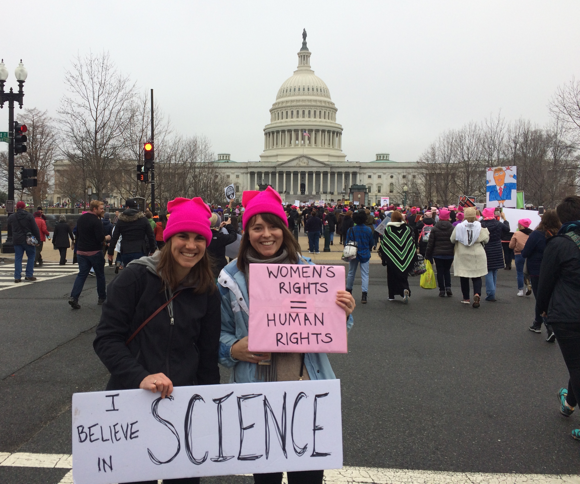
‘Izay mitambatra vato, izay misaraka fasika’

Slide 3
Our goals for the Women’s March on Saturday: Ny tanjontsika amin'ny Diaben'ny Vehivavy amin'ny Asabotsy dia: 1.) Bring people from the community together (CVB, Ranomafana, E2M2, fokontany, sns.) to promote women’s rights and show solidarity. Mitarika ny olona avy amin'ny fiaraha-monina (CVB, Ranomafana, E2M2, fokontany, sns—vahiny sy Malagasy, vehivavy sy lehilahy) Mba hanome lanja ny zon'ny vehivavy sy hanehoana firaisankina. 2.) Promote the importance of education for women, women in science, and more women in government and leadership roles. Manome lanja ny fanabeazana ho an'ny vehivavy, vehivavy eo amin'ny siansa ary ny filàna vehivavy maro kokoa eo amin’ny sehatry ny fanjakana sy ny fahaiza-mitarika

Slide 4
Examples of gender inequality in the U.S. & Madagascar: Ohatra momba ny tsy fitovan'ny lahy sy ny vavy amin’ny U.S. sy eto Madagasikara: 1.) Often women and men are not paid the same salary for doing the same job. Matetika ny vehivavy sy ny lehilahy no tsy mandray karama mitovy nefa ny asa izay nataon’izireo dia mitovy. 2.)Here in Madagascar, there is gender discrimination in land inheritance rights, especially in rural areas in the east. Eto Madagasikara, indrindra amin’ny ambanivolo atsinanana , ny lehilahy mahazo lova bebe kokoa noho ny vehivavy na ny vehivavy dia tsy mandova.

Slide 5
3.) Men often get more recognition for work (especially in science) than women, they are underrepresented in this field. Matetika ny lehilahy no mahazo fankasitrahana bebe kokoa amin'ny asa (indrindra amin'ny siansa) noho ny vehivavy. 4.) As of last year, if a Malagasy woman/foreign man had a child, the child was not eligible to be a Malagasy citizen. However, if a Malagasy man/foreign woman had a child, they were granted citizenship. Raha nanan-janaka vehivavy Gasy/ vahiny Lahy ny zaza dia tsy nahazo zom-pirenena (kara-mpanondro) Malagasy ny zanaka, fa raha nanan-janaka ny lehilahy gasy/vahiny vavy dia nahazo zom-pirenena ny zanaka.

Slide 6
5.) Women represent 50% of the population, but they do not hold many positions in government/leadership roles. Vehivavy dia 50% -n'ny mponina, saingy tsy mitazona toerana maro ao amin’ny fanjakana na amin’ny asani’ mpitarika.

